Slide 1
Modeling user behaviour on the TU Delft website
Konstantinos Chronas, Tim Bruyn

Slide 2
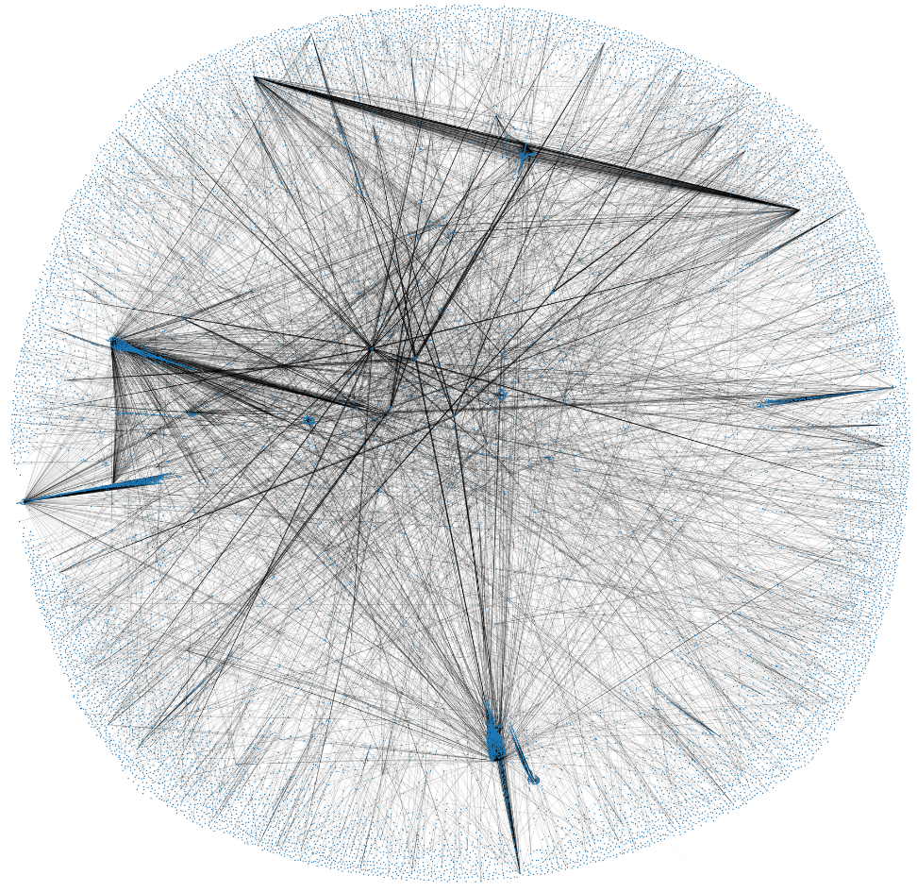
TU Delft website as graph

Slide 3
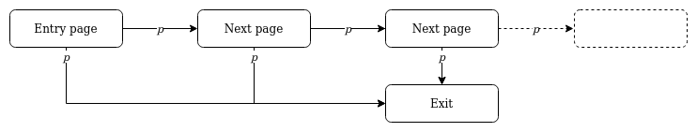
User model

Slide 4
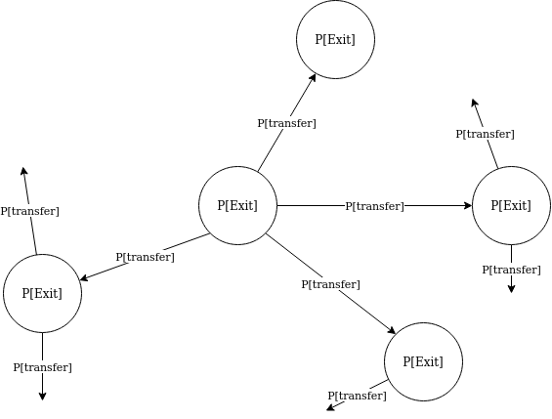
Probability graph

Slide 5
Research questions
How can P[Exit] and P[transfer] be calculated?
How can the accuracy of the model be determined?
How can the model be used to improve the TU Delft website?

Slide 6
Creating the model

Slide 7
User data
For each user:
Pages visited
Simple metadata about user (country, city, organisation, etc.)
Restrictions:
No history (only data from the visitors of today)
No cookies: If same user goes to the website in two browser sessions, it is registered as different users
Pages as unordered list

Slide 8
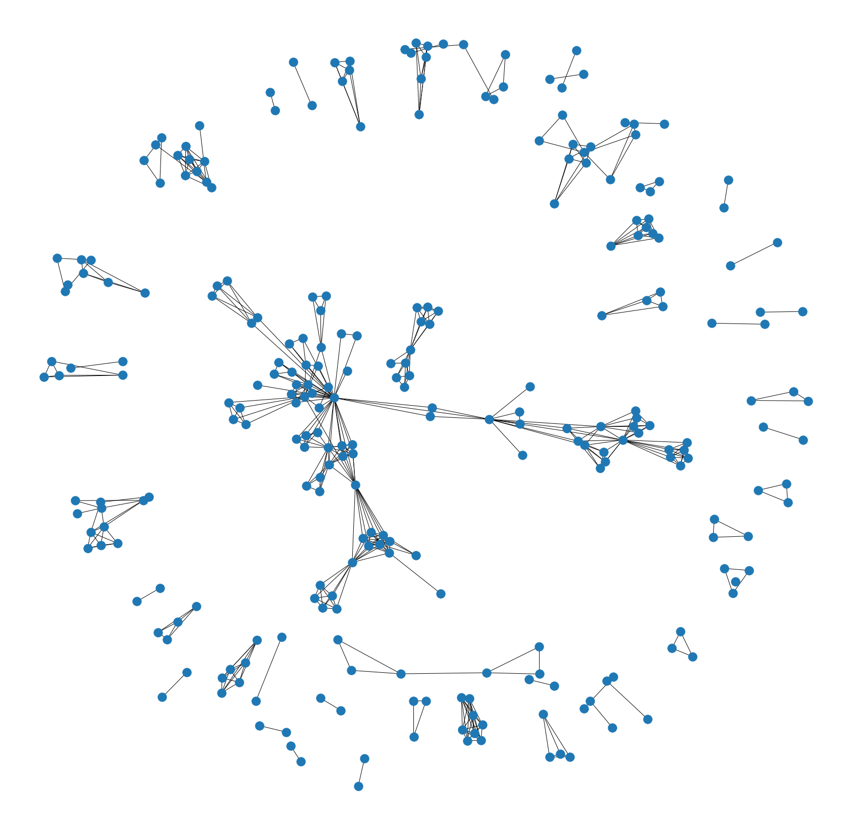
Traffic graph
Nodes: pages visited by users
Edge (u, v): if u and v are visited by the same user
Weight per edge: Number of same visits / Largest number of same visits

Slide 9
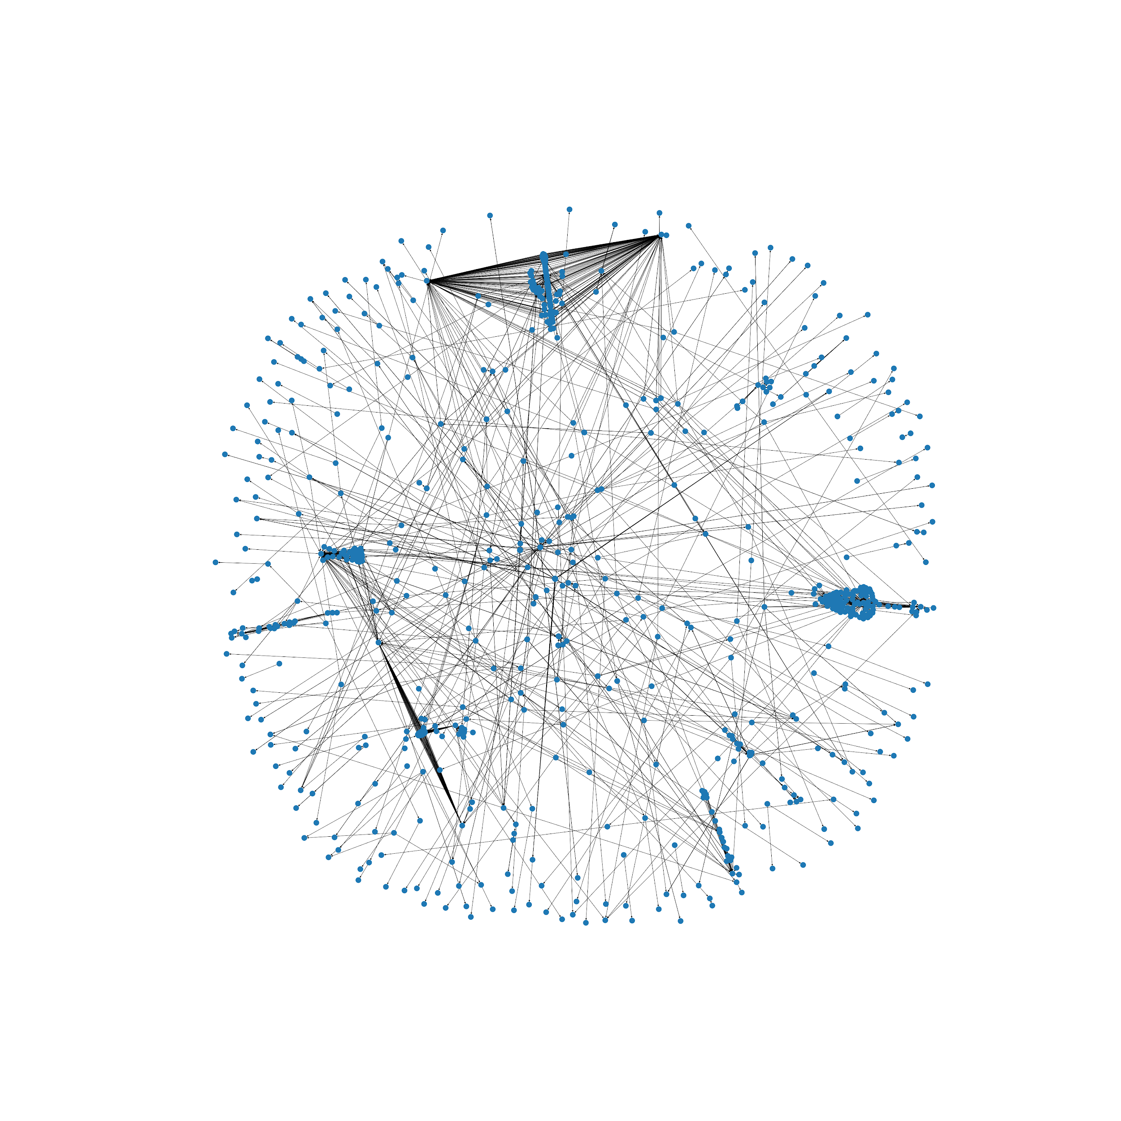
Subgraph
Full graph too large: 25062 nodes
Create subgraph:
Take all nodes from traffic graph
For each two nodes u and v in traffic graph, include all nodes in the path between u and v
For each node in new graph, include all nodes in connected component
Remove nodes with degree 0

Slide 10
Probability graph
Same network layout as the subgraph
Calculate P[Exit] and P[transfer] for each node and edge according to different metrics
P[u -> v] = (metric of v) / (sum of metric of all neighbours of u + metric u) P[exit u] = (metric of u) / (sum of metric of all neighbours of u + metric u)

Slide 11
Probability graph
Metrics:
Pageviews
Pagerank
Betweenness
Inverted betweenness
Degree
Inverted degree

Slide 12
Probability graph
Create probability graphs for each separate metric
Compare accuracy of metric
Create probability graph with multiple metrics
Each metric is given a weight based on performance

Slide 13
Validating the model

Slide 14
Compare model with user data
For each probability graph, generate virtual user traffic
Compare the traffic graph of the virtual user traffic with the traffic graph of the actual user traffic

Slide 15
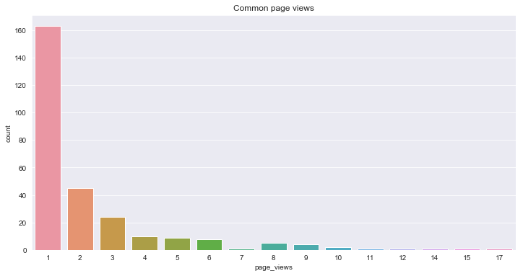
Characteristics of actual traffic graph

Slide 16
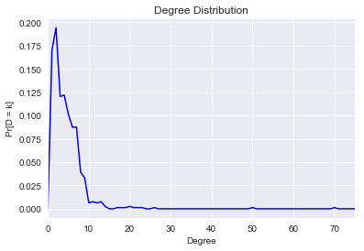
Characteristics of actual traffic graph

Slide 17
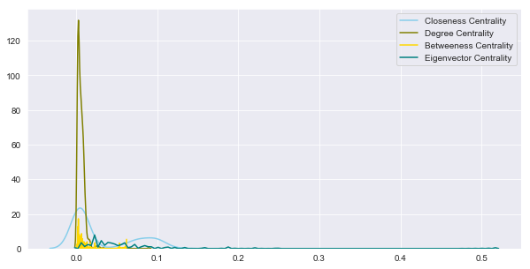
Characteristics of actual traffic graph

Slide 18
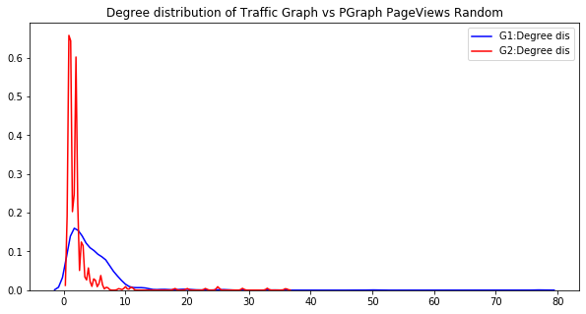
Comparison with virtual traffic graphs

Slide 19
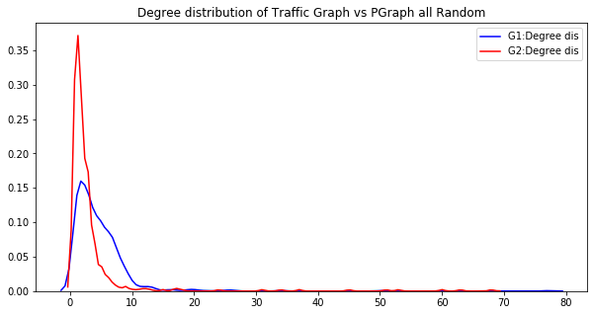
Comparison with virtual traffic graphs

Slide 20
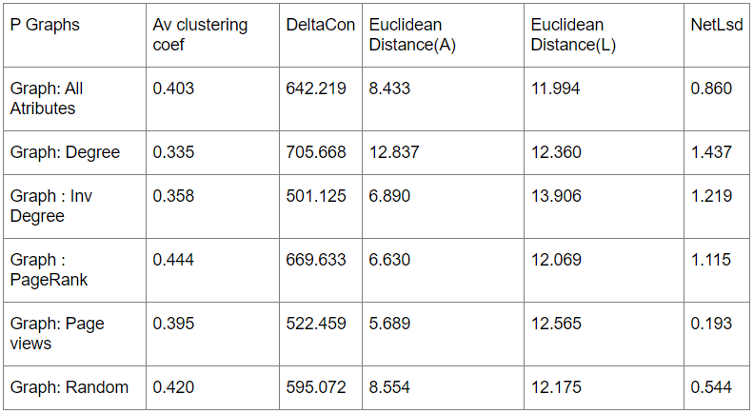
Comparison with virtual traffic graphs
Random initialization

Slide 21
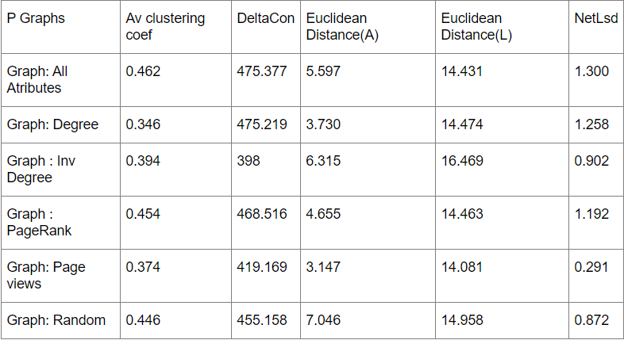
Comparison with virtual traffic graphs
Selected entry points

Slide 22
Influence of webpages

Slide 23
How can TU Delft get more pageviews
User case:
If TU Delft links to webpages, e.g. through social media, which pages will generate most overall traffic?

Slide 24
Top 5 most influential pages
 | Total extra views | Average distance | Max distance
http://ocw.tudelft.nl | 2872 | 2.87 | 17
https://tresor.tudelft.nl | 2850 | 2.85 | 11
https://ocw.tudelft.nl | 2737 | 2.74 | 17
https://ocw.tudelft.nl/courses/introduction-seismic-essentials-groningen/ | 2712 | 2.71 | 18
https://www.tudelft.nl/en/research/faculties-and-disciplines/ | 2615 | 2.61 | 8

Slide 25
Modeling user behaviour on the TU Delft website
Konstantinos Chronas, Tim Bruyn

